Slide 1

16881A0368

Slide 2
ANALYSIS OF WIND TURBINE BLADE
SOFTWARE USED :
ANSYS WORKBENCH
MATERIAL USED :
ALUMINIUM ALLOY

Slide 3
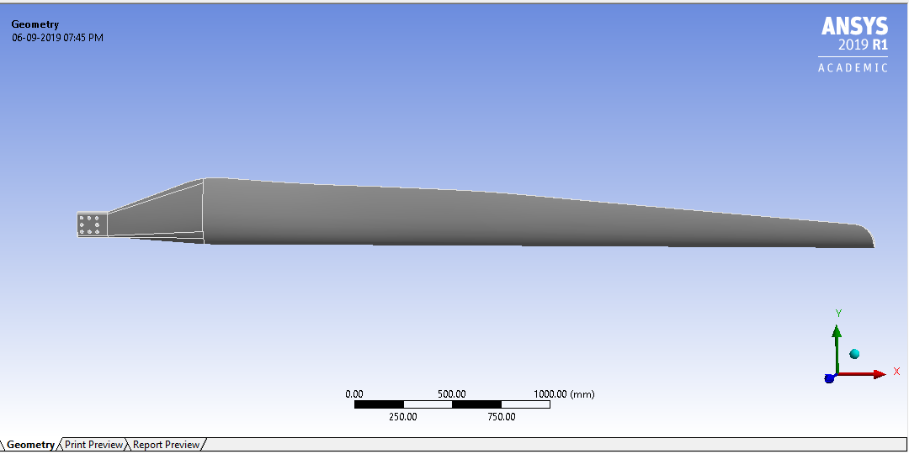
WIND TURBINE BLADE

Slide 4
ANALYSIS :
CASE 1 :
Perform Transient Structural Analysis with linked modal Analysis with the following inputs :
Max Pressure : 101325 Pa
Apply Pressure on the blade and constraint the end locations ( i.e, holes)
Perform the Analysis for 100 sec.
MODAL ANALYSIS :
Perform the modal analysis with pre-stress condition as static structural analysis :
Number of modes to find : 6
OUTPUT :
Stress (Von-Mises)
Deformation
Strain
Factor of safety.

Slide 5
CASE 2:
HARMONIC ANALYSIS :(MODE SUPERPOSITION)
Max Frequency : 300 Hz
Max Pressure : 101325 Pa
Apply pressure on the blade and constraint the end location( i.e, holes)
OUTPUT:
Displacement(Vs)Frequency.
CASE 3:
FATIGUE ANALYSIS :
Using the above conditions perform fatigue analysis
OUTPUT :
Life
Damage.

Slide 6
DETAILS OF MESH
Mesh size : Max element size-34 mm
Min element size-19 mm
Element order : linear
Element size : default
Mesh type : 3-D,Tetra-meshing
Element shape : Tetra hedron
NODES : 4024
ELEMENTS : 15287

Slide 7
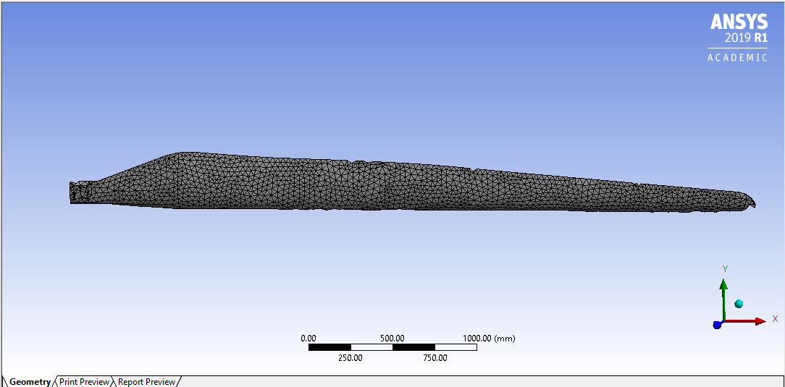
MESH

Slide 8
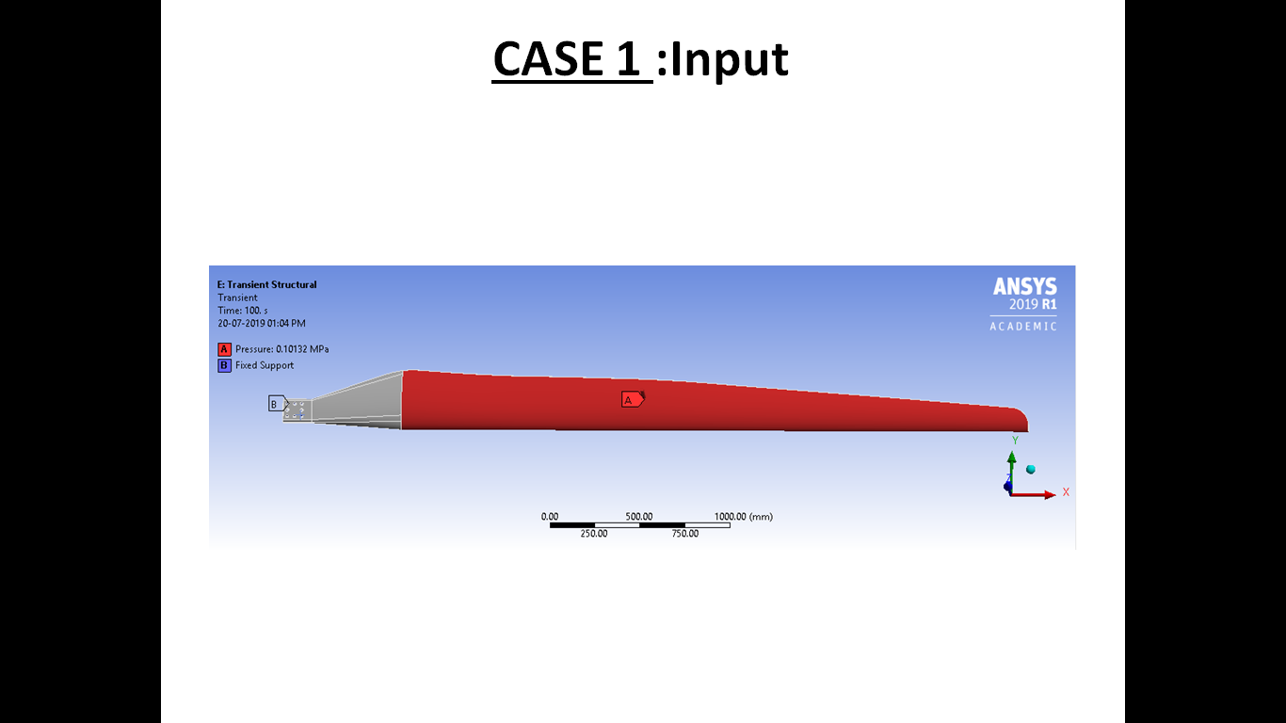

Slide 9
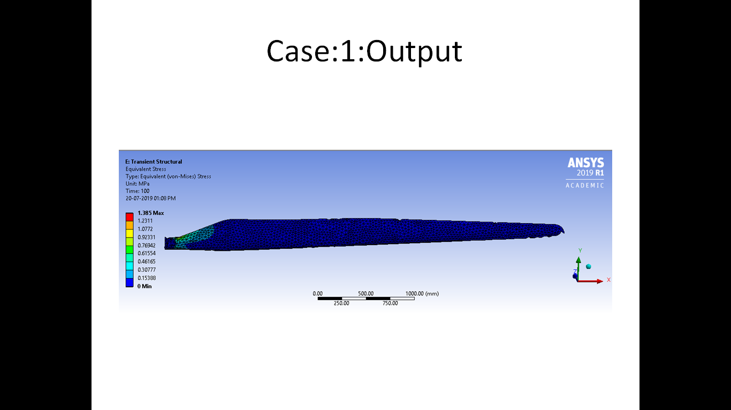

Slide 10
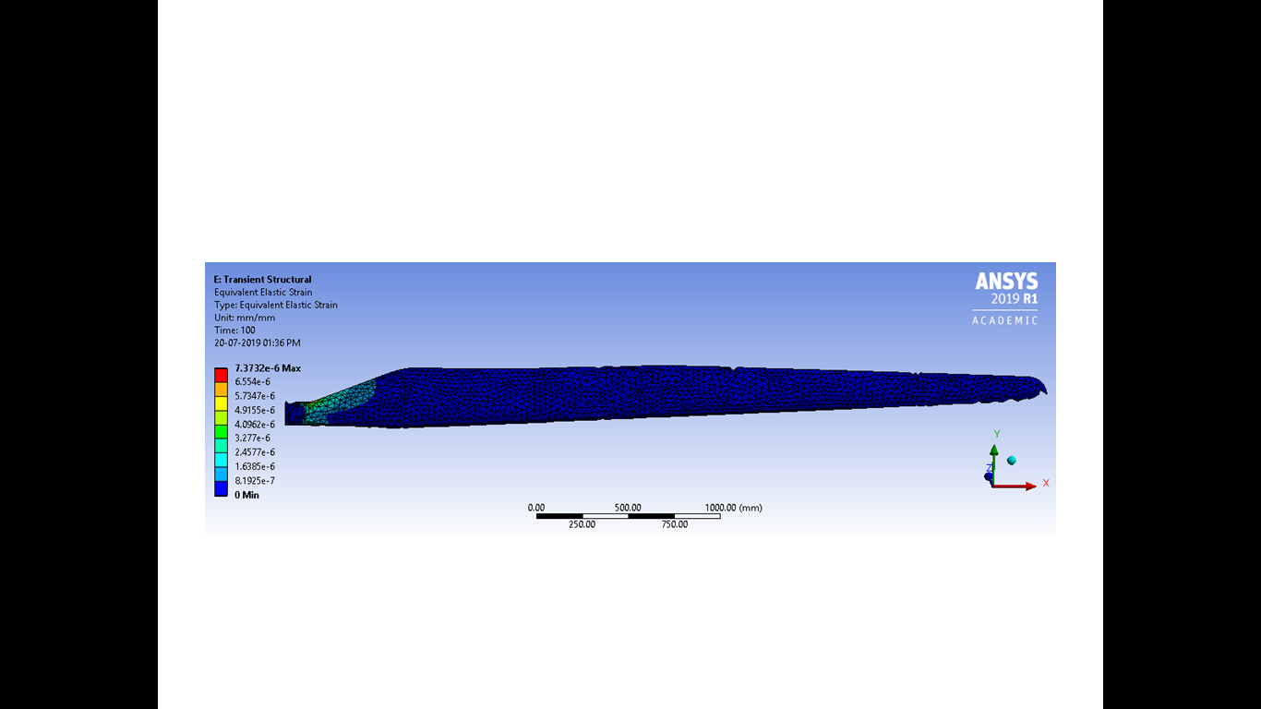

Slide 11
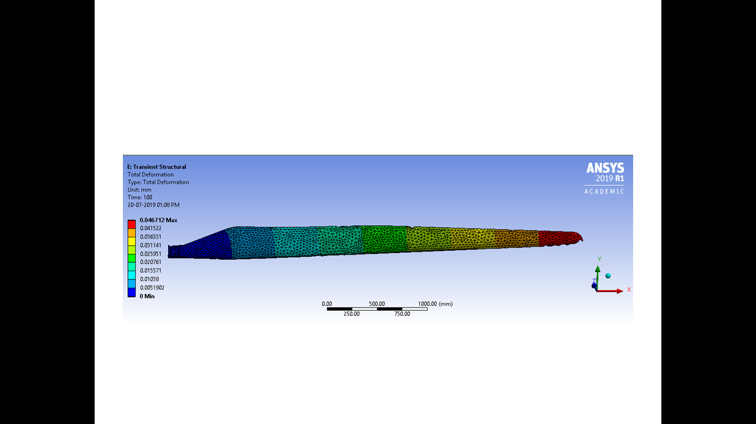

Slide 12
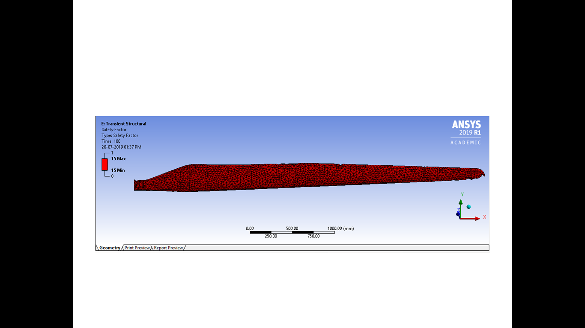

Slide 13
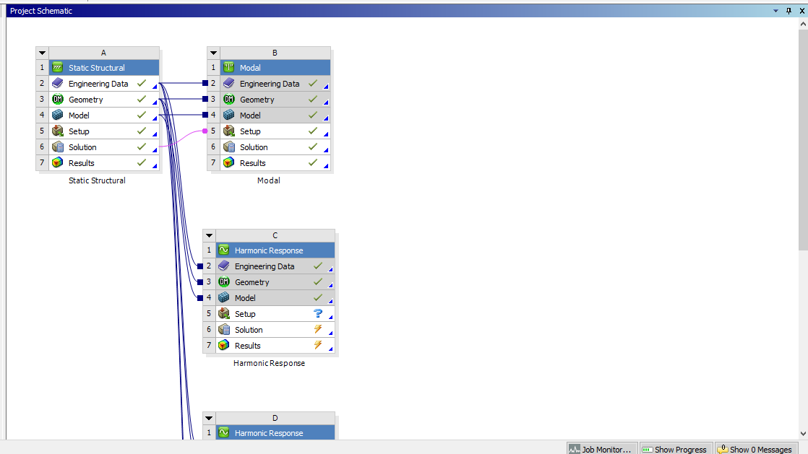
LINKING STRUCTURAL WITH MODAL

Slide 14
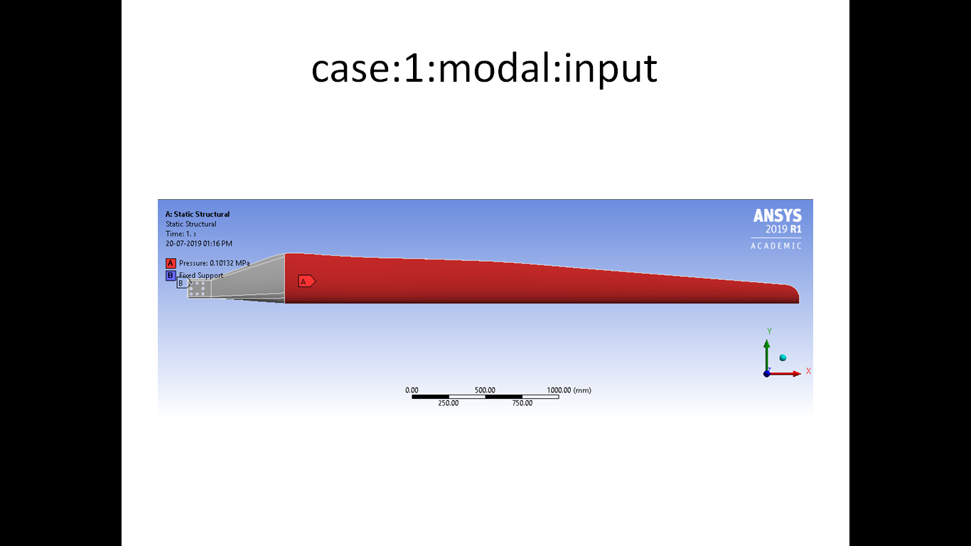

Slide 15
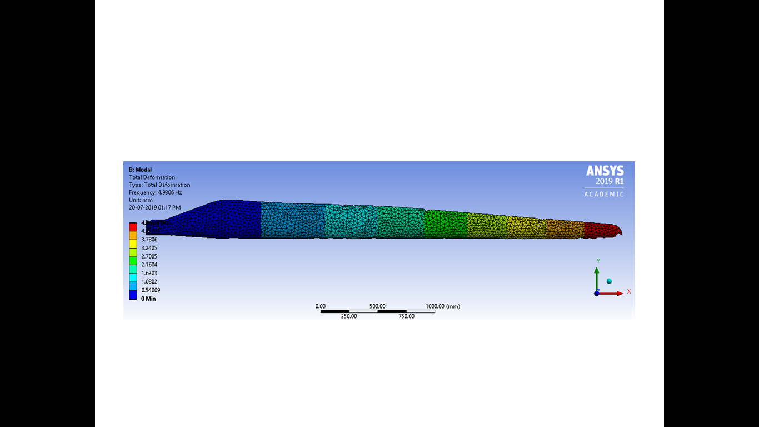

Slide 16
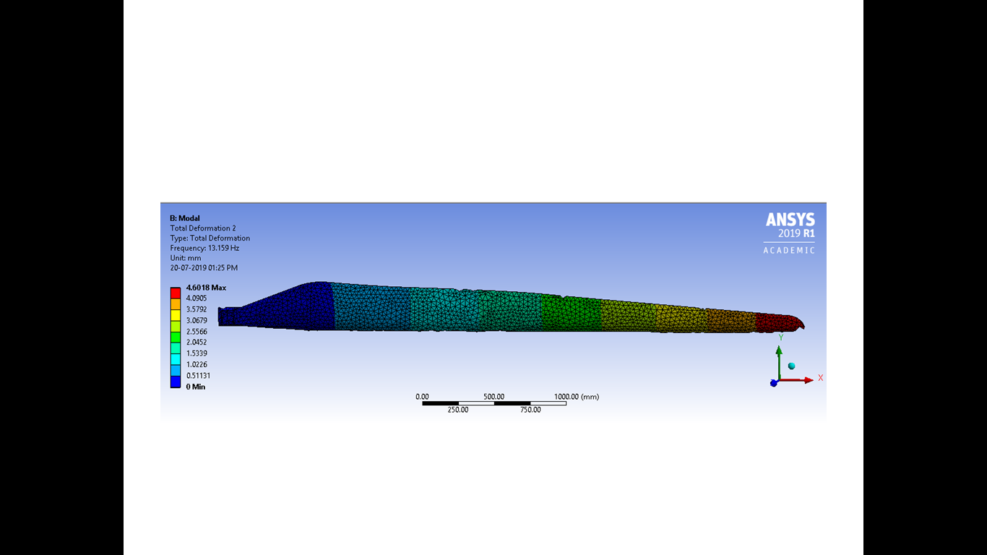

Slide 17
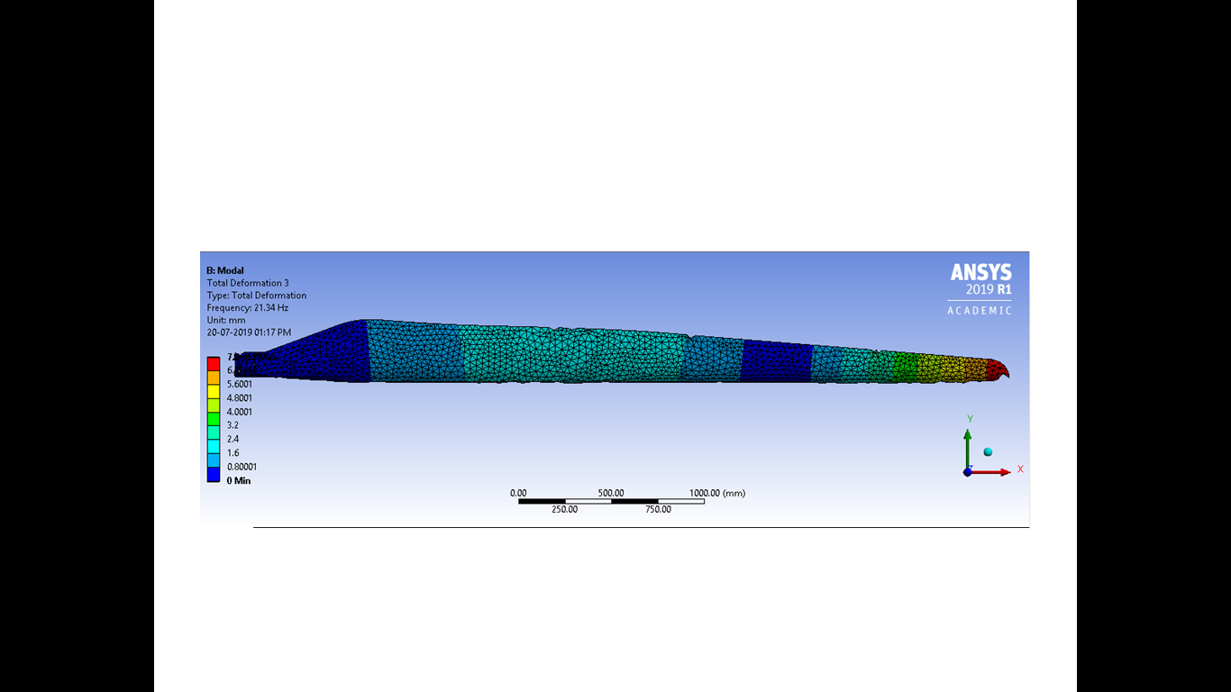

Slide 18
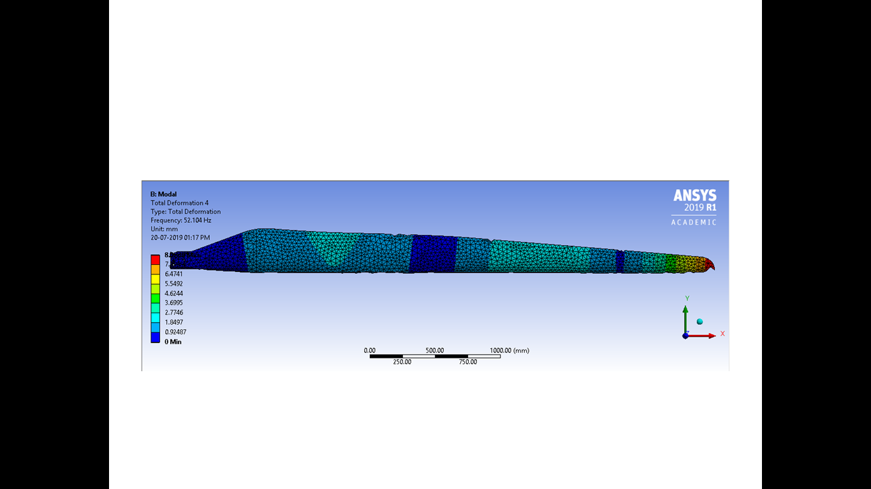

Slide 19
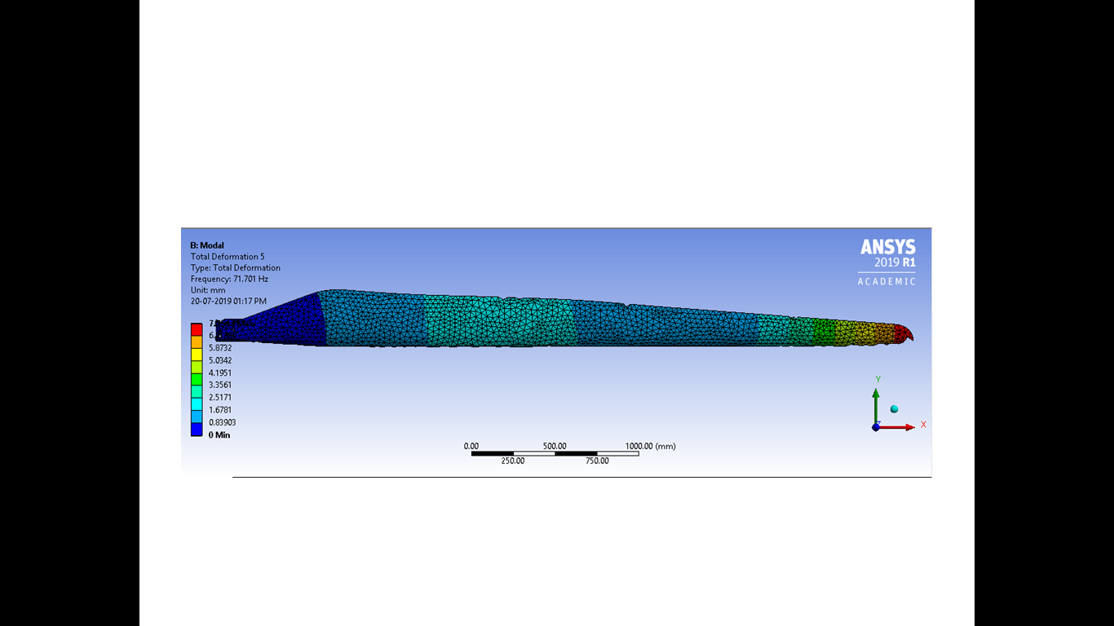

Slide 20
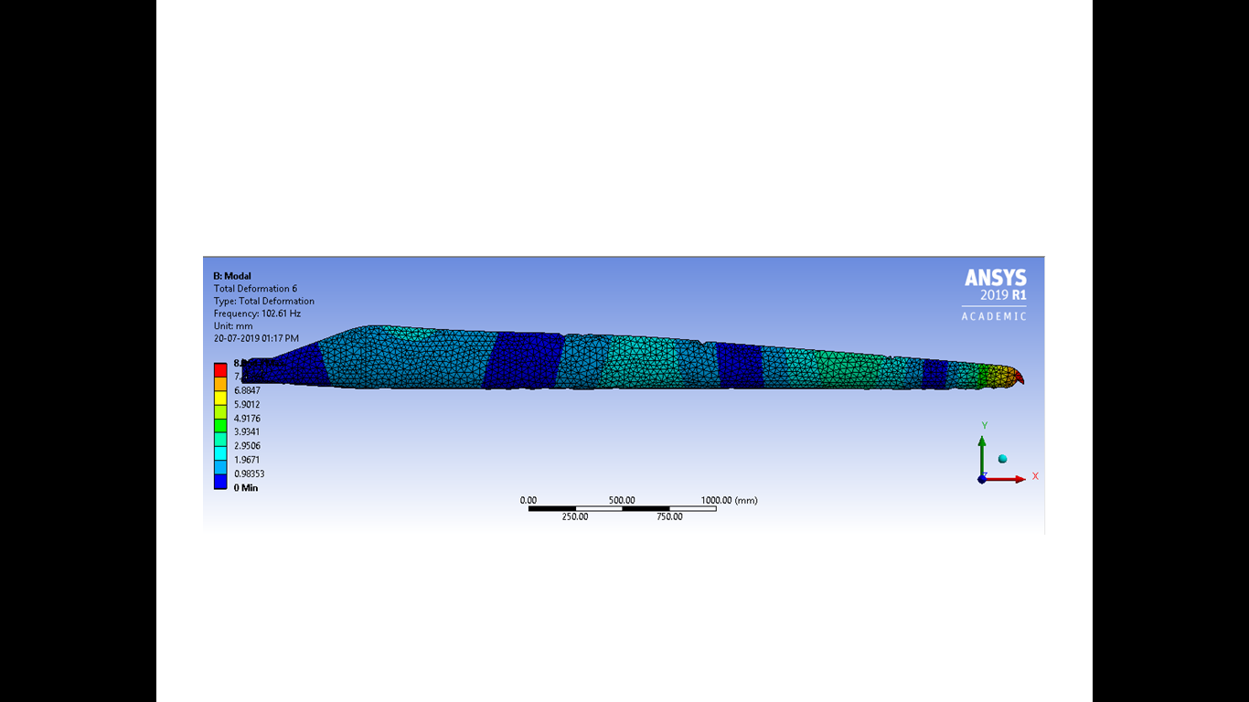

Slide 21
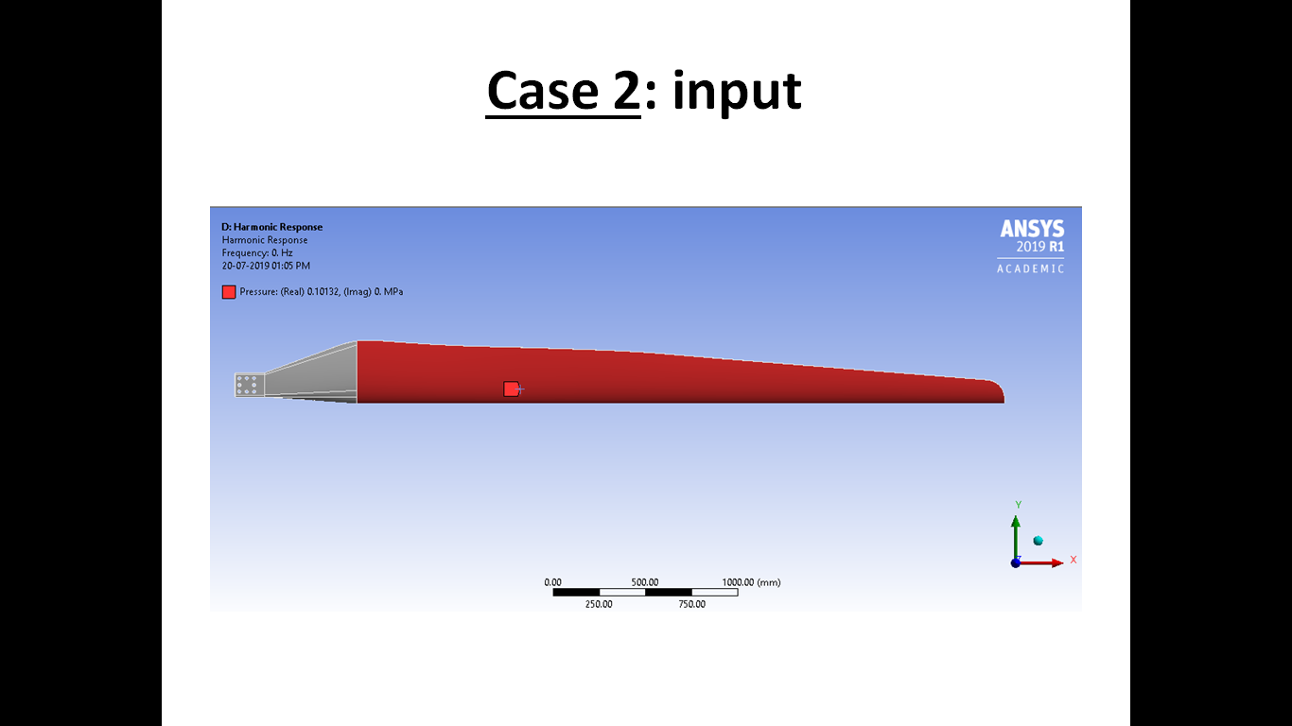

Slide 22
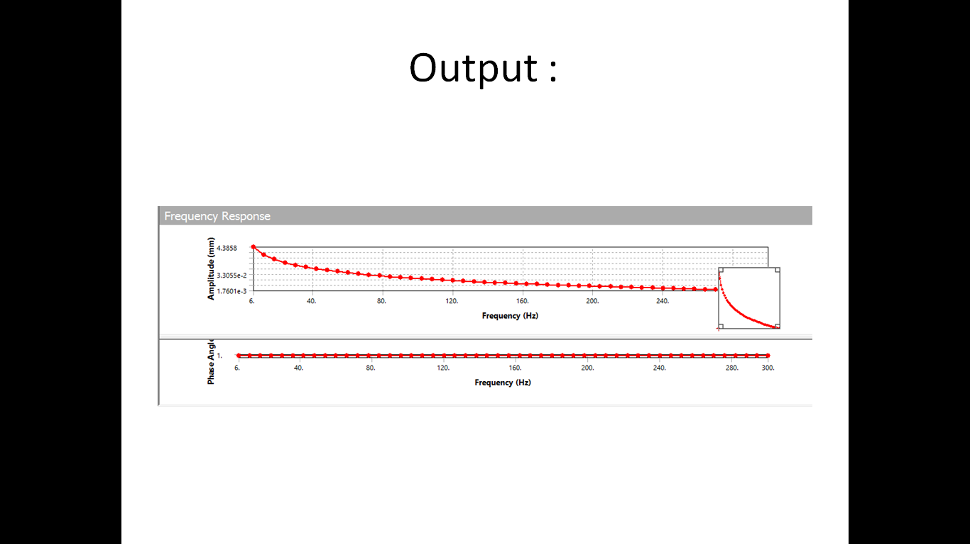

Slide 23
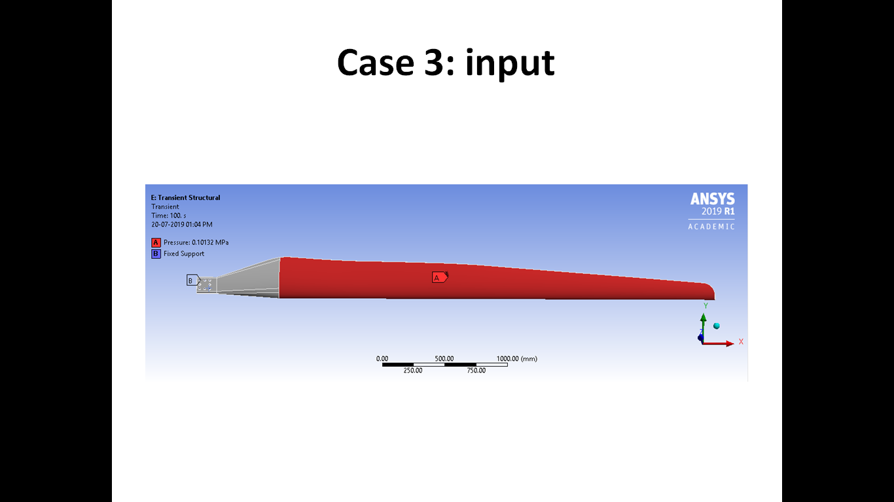

Slide 24
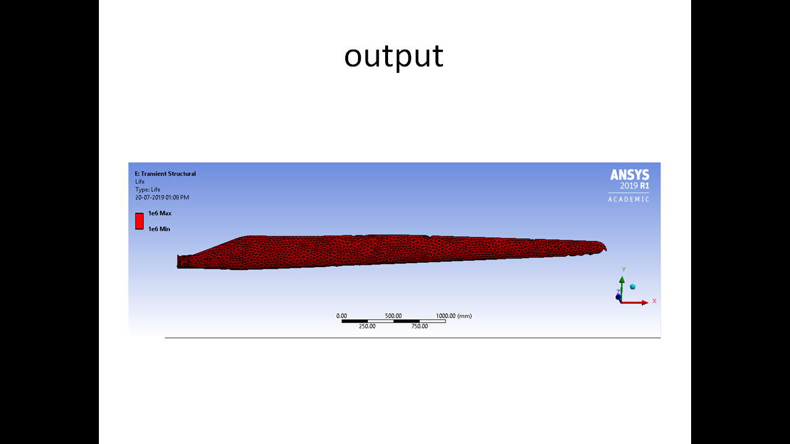

Slide 25
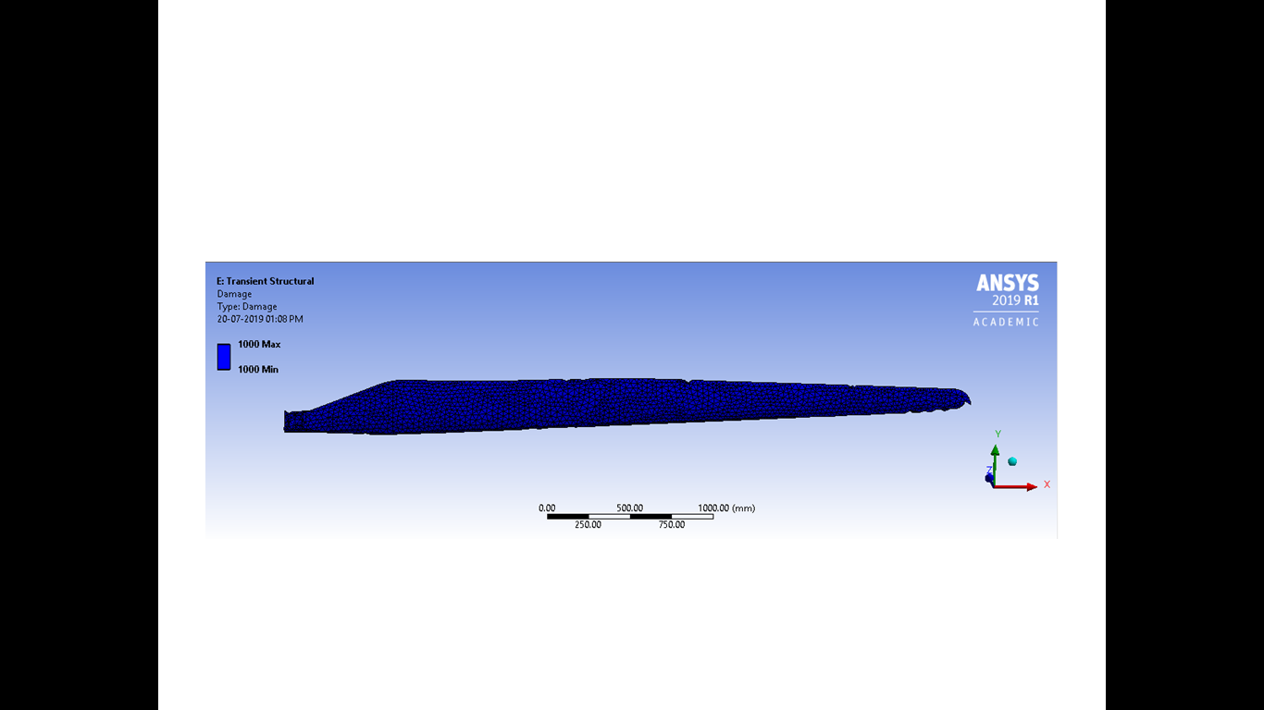

Slide 26
As I have calculated the deformation,stress,strain,factor of safety with aluminium and the same is shown as below
 | DEFORMATION | STRESS | STRAIN | SAFETY FACTOR
TRANSIENT | 0.046712 | 1.385 | 7.73732e-6 | 15
DEFORMATION | 1 | 2 | 3 | 4 | 5 | 6
MODAL ANALYSIS | 4.0685 | 4.6018 | 7.2081 | 8.086 | 7.0641 | 8.0541
 | LIFE | DAMAGE
FATIQUE ANALYSIS | 1e6 | 1000

Slide 27
CONCLUSION
In this project I worked on wind mill turbine blade and analysis is done in ansys software . Analysis like transient ,modal , harmonic and fatique were performed to find stress ,strain , factor of safety and deformation , etc.
From the observation regarding the values obtained I can conclude that Aluminium Alloy can be best suited for wind turbine blade and it has given best results.

Slide 28
Thank you
.

